Slide 1

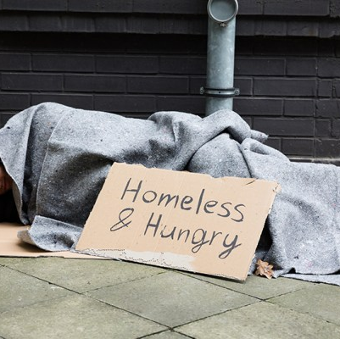

Marketing and Customer Analytics in Housing for Individuals Experiencing Homelessness
By: Mercy D Harris, Zariana R Mobley and Braeden S Baker

Slide 2
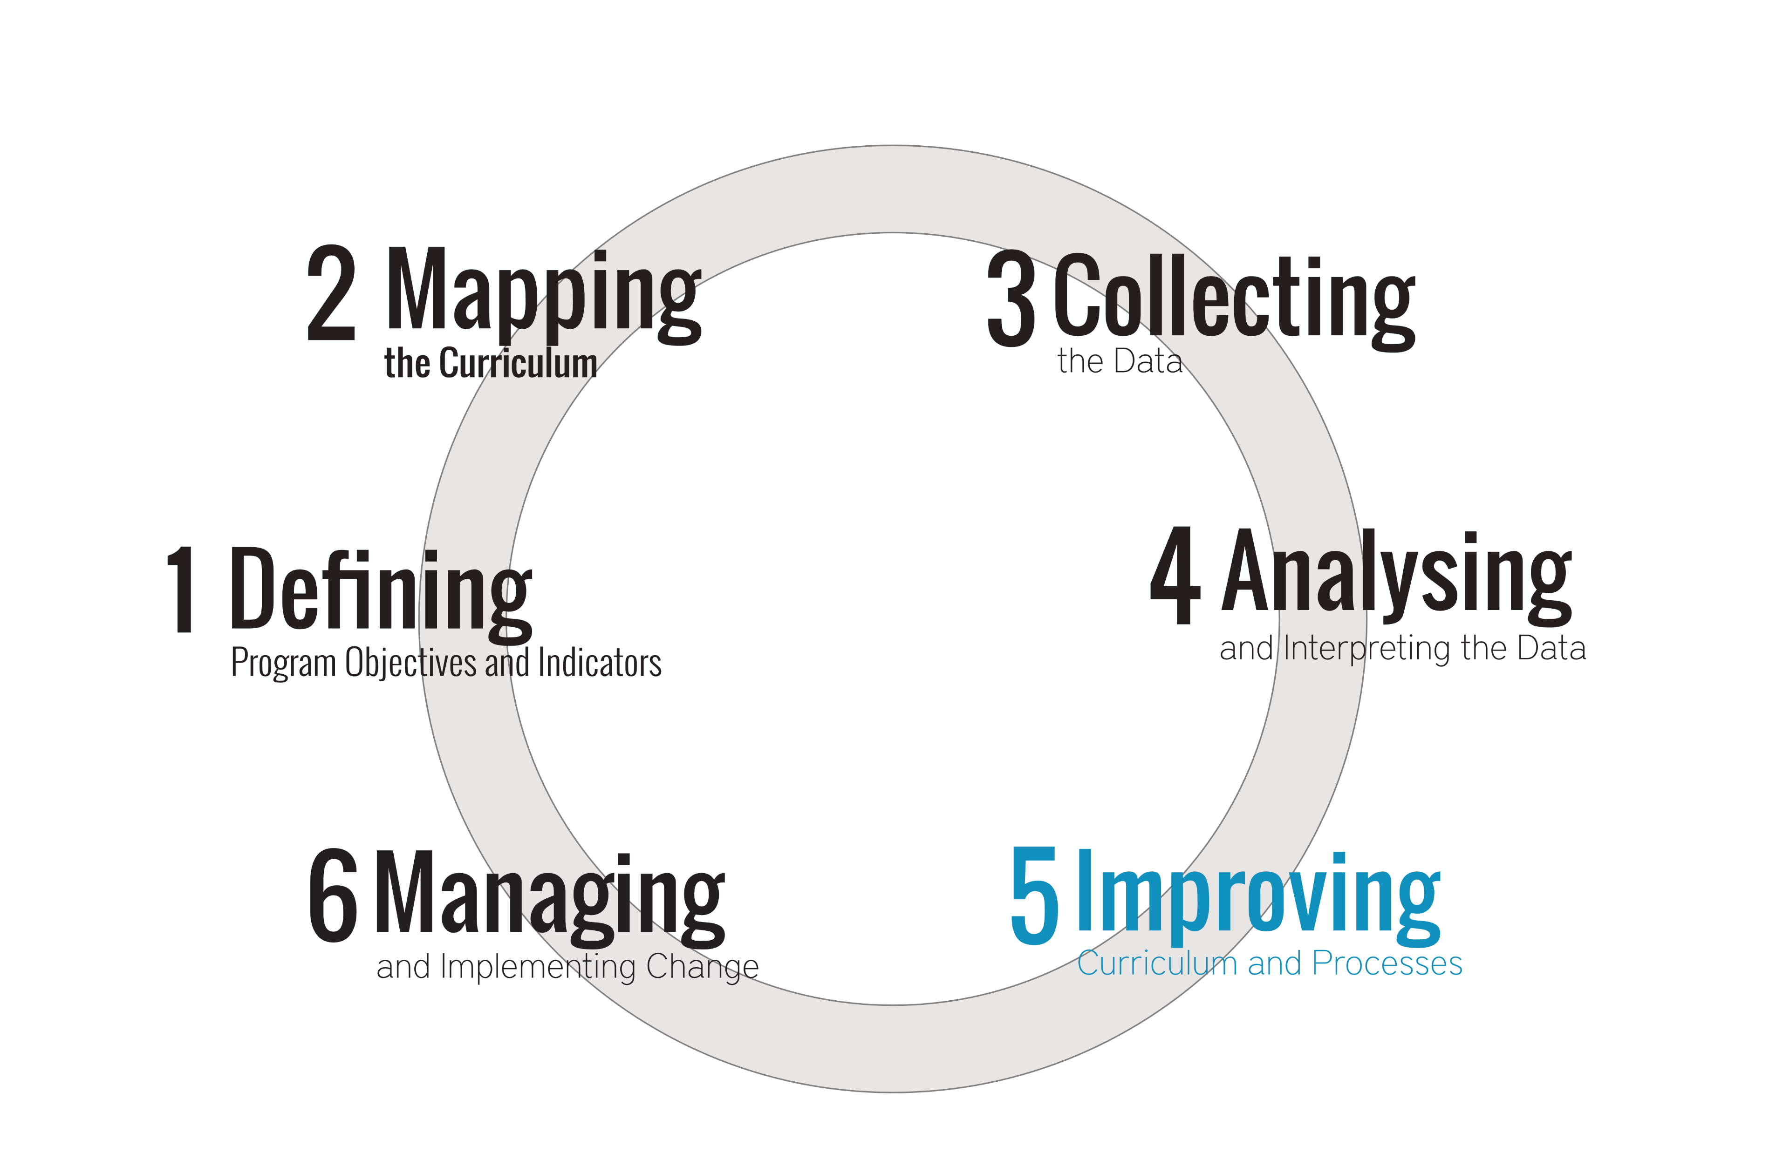
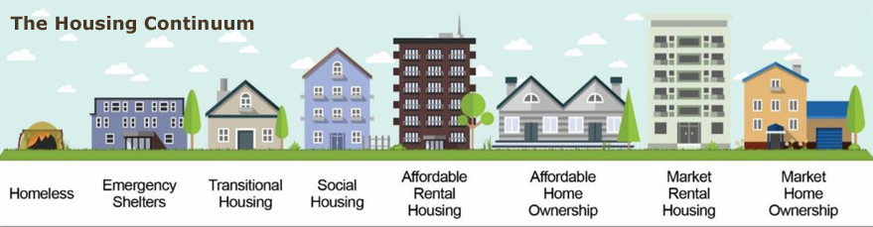

Introduction / Project Overview
Focus: Apply customer analytics to improve housing outreach
Goal: Strengthen engagement, increase program participation, and support long‑term housing stability
Approach: Mixed‑methods analysis combining quantitative PIT data and qualitative interviews
Notes:
This project explores how customer analytics can be applied to housing services. Instead of viewing individuals simply as service recipients, we approach them as “customers” navigating a system with multiple steps and barriers.
We focus on three key areas: outreach effectiveness, engagement patterns, and barriers to participation in housing programs.
Our goal is to develop data-driven recommendations that strengthen outreach strategies, increase participation in housing programs, and ultimately improve long-term housing stability.
To do this, we use a mixed-methods approach, combining quantitative data analysis with qualitative insights from interviews and research.

Slide 3



Motivation
Homelessness remains a major social and economic challenge
Limited visibility into customer journey
Organizations cannot identify conversion bottlenecks
Need for innovative, measurable strategies to connect people with stable housing
Notes:
Homelessness continues to be a major social and economic challenge in the United States. Many individuals face barriers such as limited access to housing resources, lack of documentation, and difficulty navigating complex assistance systems.
Organizations and nonprofits play a critical role in addressing these issues, but many outreach strategies are not consistently evaluated. This makes it difficult to determine what is actually working.
As a result, there are missed opportunities to improve engagement and placement outcomes.
This project is motivated by the need for more effective, measurable, and data-driven approaches to help individuals access stable housing faster and more efficiently.

Slide 4
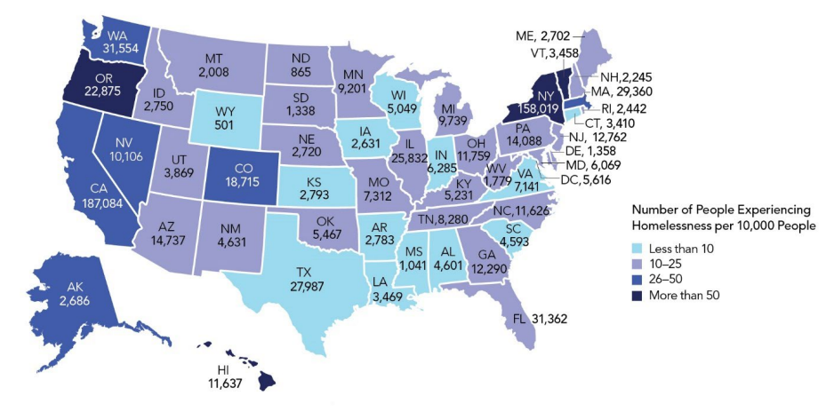


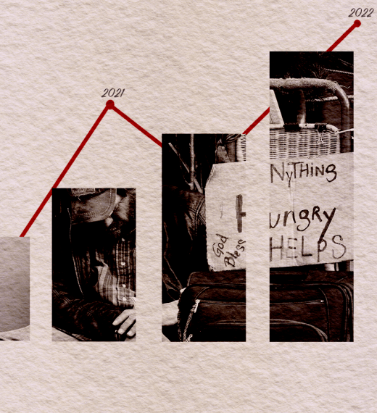
Project Goals
Measure system performance with basic KPI establishment
Identify breakdowns in housing conversion funnel
Provide data-driven recommendations for outreach + capacity
Notes:
The main goal of this project is to create a framework for better identifying, engaging, and supporting individuals experiencing homelessness.
We focus on four key areas: segmentation, outreach optimization, personalized matching, and performance measurement.
We also aim to establish key performance indicators, or KPIs, to evaluate system effectiveness. These include measures like housing placement rates and engagement levels.
By analyzing the housing “conversion funnel,” we can identify where individuals drop off in the process and provide targeted recommendations to improve outreach strategies and overall system performance.

Slide 5
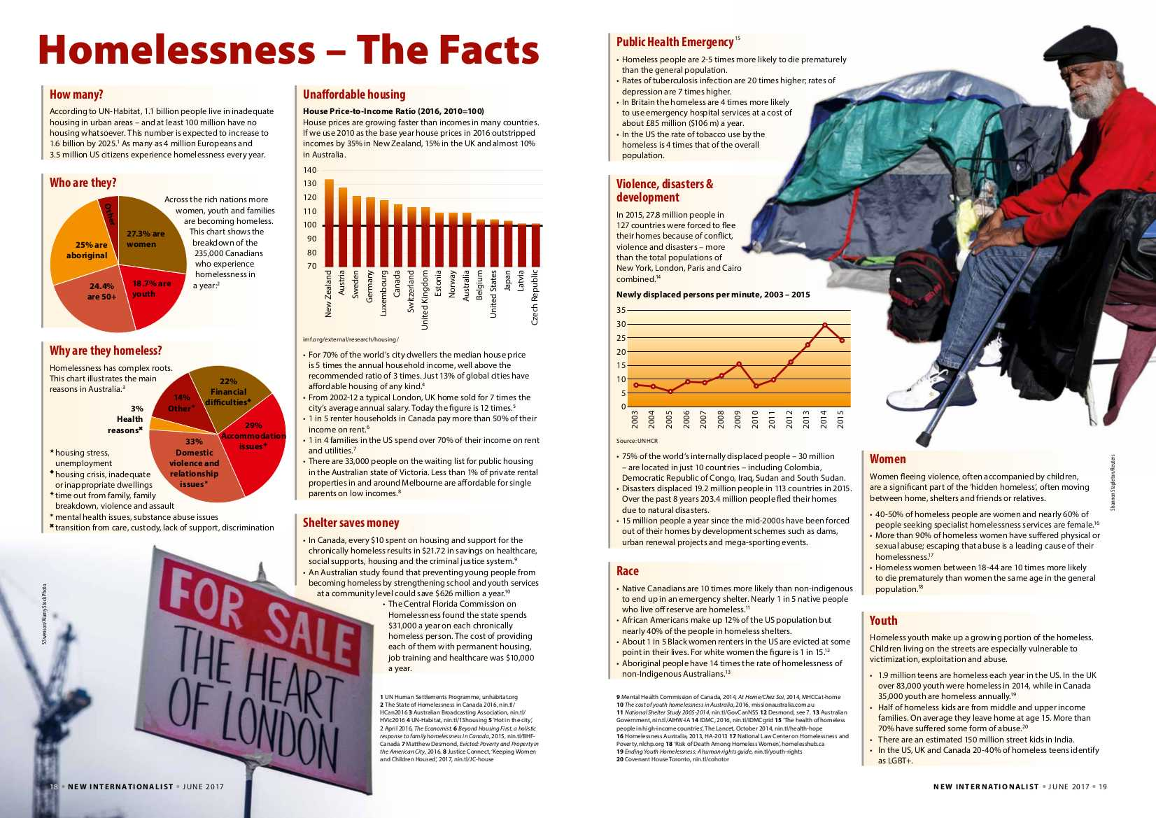
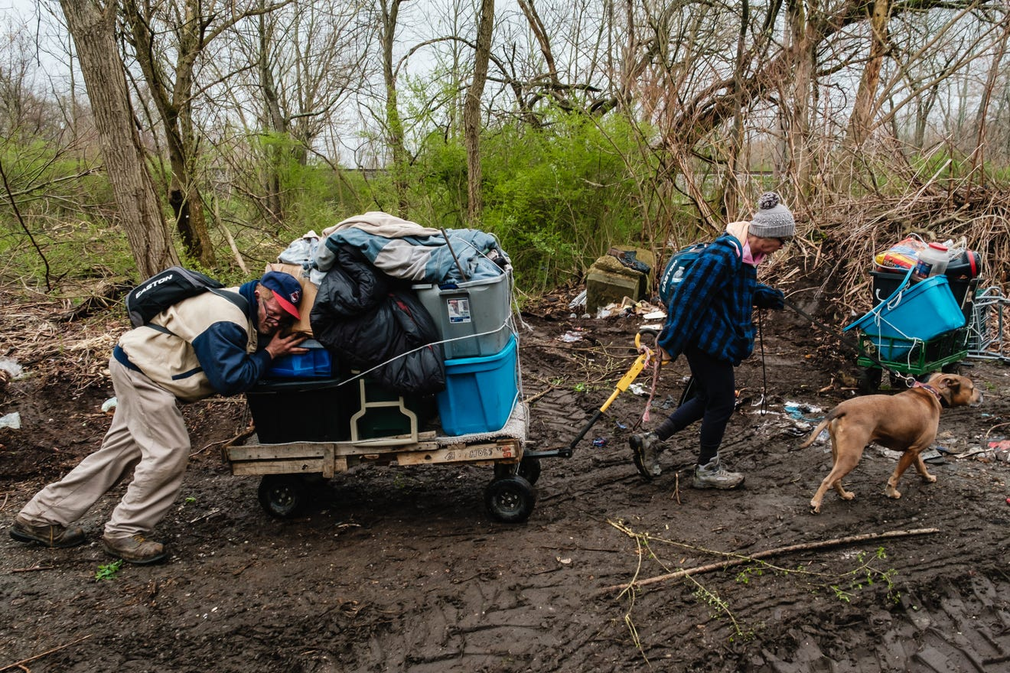
Objective 1: Customer Segmentation
Identify distinct needs and barriers across population segments
Use qualitative insights to understand documentation and access issues
Notes:
Our first objective is customer segmentation. Not all individuals experiencing homelessness have the same needs, barriers, or circumstances.
Using demographic data, housing history, and qualitative insights, we identify distinct population segments. For example, some individuals may face documentation issues, while others may struggle with access to transportation or communication barriers.
By understanding these differences, organizations can tailor their outreach and services more effectively.
Instead of using a one-size-fits-all approach, segmentation allows for targeted interventions that better meet the needs of each group and improve overall outcomes.

Slide 6
Objective 2: Outreach Channel Optimization
Evaluate current outreach methods:
Street outreach
Shelters
Community events
Test new strategies:
Digital outreach
Community partnerships
Peer‑to‑peer engagement
Notes:
The second objective focuses on improving outreach methods. We evaluate current strategies such as street outreach, shelters, and community events to determine how effective they are.
We also explore new approaches, including digital outreach, partnerships with community organizations, and peer-to-peer engagement.
Different individuals respond to different communication channels, so it’s important to diversify outreach efforts.
The goal is to identify which methods are most effective at reaching individuals, increasing engagement, and ultimately guiding them into housing programs.

Slide 7
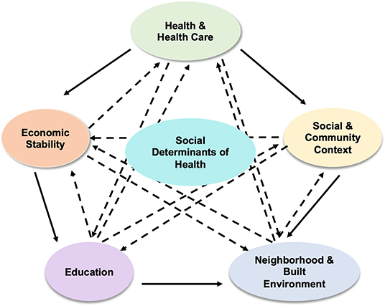

Objective 3: Personalized Resource Matching
Match individuals to housing programs based on needs + eligibility
Develop tools for outreach workers to guide clients through:
Application processes
Program navigation
Transition to stable housing
Notes:
The third objective is personalized resource matching. This involves connecting individuals with housing programs that best fit their needs and eligibility.
We propose developing tools that help outreach workers guide individuals through application processes, program navigation, and the transition to stable housing.
This reduces confusion and improves efficiency for both clients and organizations.
The idea is to ensure that each individual is matched with the right resource at the right time, increasing the likelihood of successful placement and long-term housing stability.

Slide 8
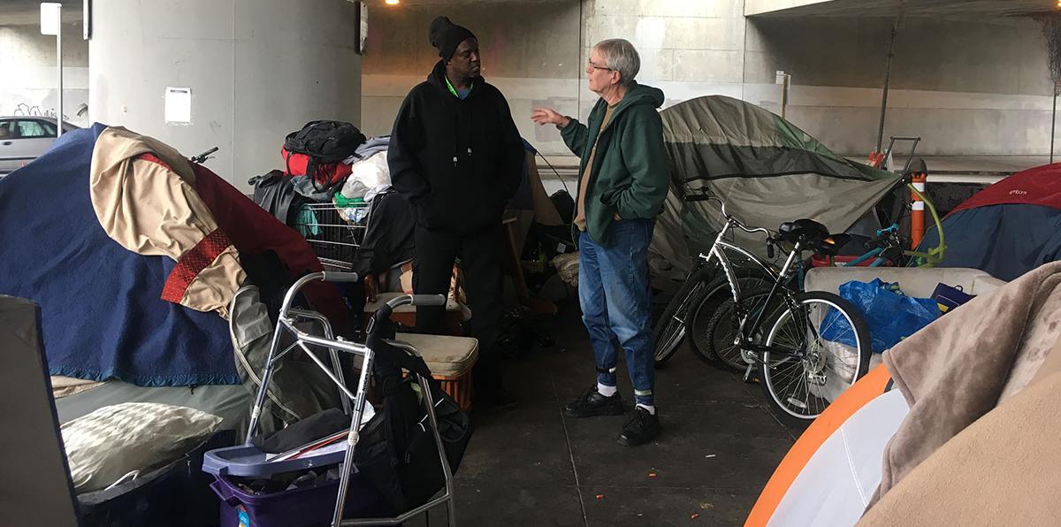
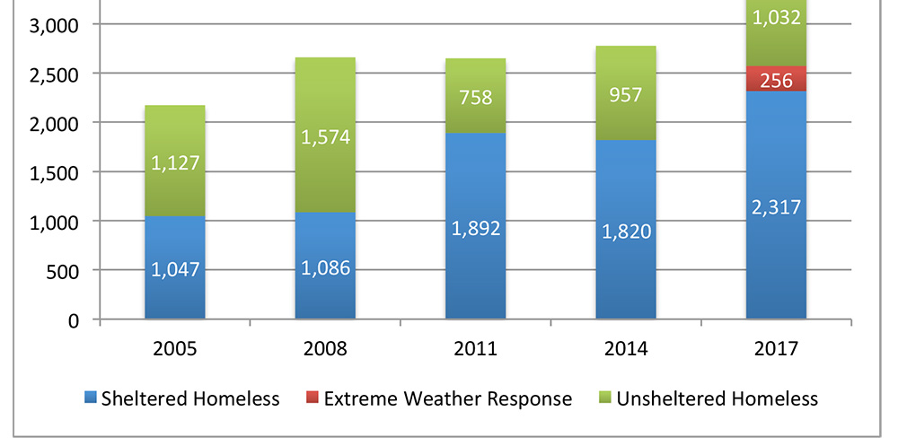
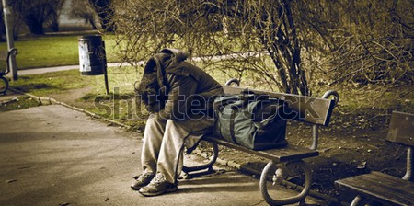
Objective 4: Impact Measurement
Establish KPIs:
Total homelessness
Sheltered vs. unsheltered population
Housing placement rates
Repeat homelessness
Create a feedback loop for continuous improvement
Notes:
Our fourth objective focuses on measuring impact. To do this, we establish key performance indicators such as total homelessness, sheltered versus unsheltered populations, housing placement rates, and repeat homelessness.
These metrics help organizations track performance and identify areas for improvement.
We also emphasize creating a feedback loop, where data is continuously used to refine strategies and improve outcomes over time.
This ensures that outreach efforts are not only implemented but also evaluated and adjusted based on real results.

Slide 9


Problem Definition
Large portion of individuals remain unsheltered
Indicates failure in conversion stage of service funnel
Lack of KPIs prevents
Identifying bottlenecks
Improving resource allocation
CORE ISSUE: Capacity + Conversion Inefficiency
Notes:
A major problem we identified is the lack of strong evaluation methods in outreach programs. Many organizations do not have clear metrics to measure success.
As a result, it’s difficult to identify where individuals drop off in the housing process, also known as the conversion funnel.
This leads to inefficiencies in resource allocation and missed opportunities to improve outcomes.
Additionally, a large portion of individuals remain unsheltered, which indicates a breakdown in the system.
Overall, the core issue is a combination of limited capacity and inefficiencies in converting outreach into successful housing placements.

Slide 10
Literature Review: Key Insights
Housing First + supportive housing show mixed results for community integration
Peer‑support interventions show promise
Machine learning can optimize resource allocation but raises equity concerns
Nonprofit marketing + social media can increase awareness and engagement
Data analytics is essential for understanding trends and improving programs
Notes:
Our literature review highlights several key insights. First, interventions like Housing First show mixed results, especially in terms of long-term community integration.
However, peer-support and psychosocial interventions appear more promising.
We also found that machine learning can improve resource allocation, but it raises concerns about fairness and equity.
Additionally, marketing strategies such as social media and storytelling can increase awareness and engagement.
Overall, the research emphasizes that data analytics is essential for understanding trends, improving outreach strategies, and making informed decisions.

Slide 11
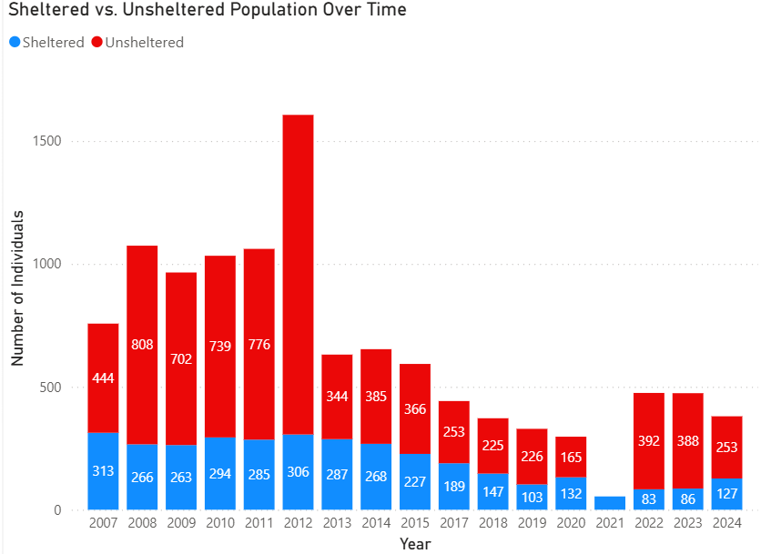
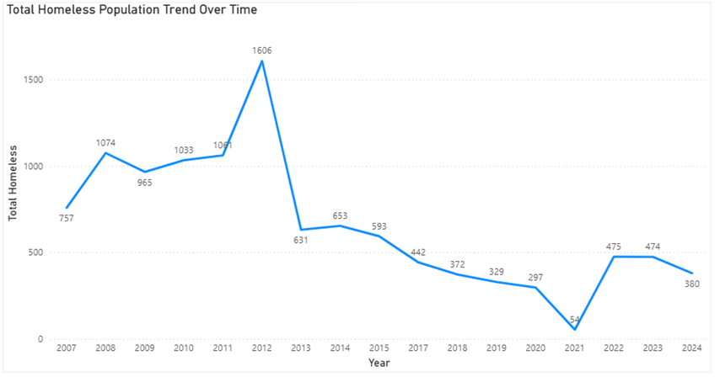
Data Collection
Quantitative: HUD Point‑in‑Time (PIT) data (2007–2024)
Qualitative: Interview with a local organization with valuable insight on the inside
Limitation: Lack of granular, individual-level tracking

Slide 12
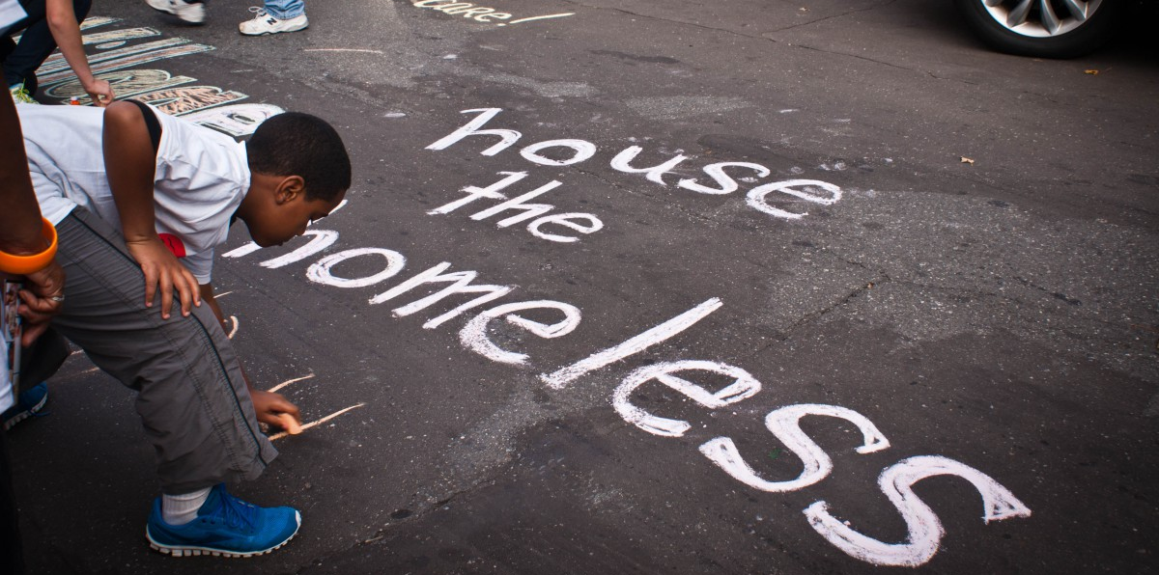
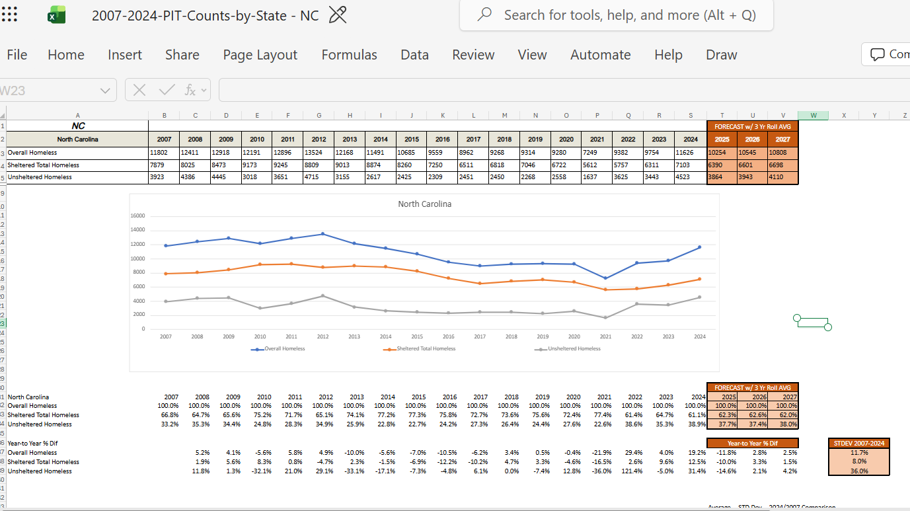
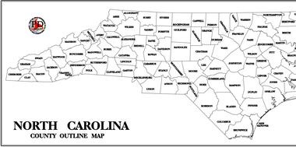
Methodology
Mixed – Method approach
PIT data cleaned + consolidated in Power BI
KPIs developed to assess system performance
Interview data coded for segmentation + barrier identification
Iterative analysis to refine outreach strategies
Notes:
We use a mixed-methods approach that combines quantitative analysis with qualitative insights.
Quantitative data is cleaned and analyzed using Power BI to identify trends and develop key performance indicators.
Qualitative data from interviews is coded and transformed into variables that can be analyzed alongside the quantitative data.
This allows us to identify patterns, segment populations, and understand barriers more effectively.
Our approach is iterative, meaning we continuously refine strategies based on new data and insights to improve outreach and housing outcomes.

Slide 13
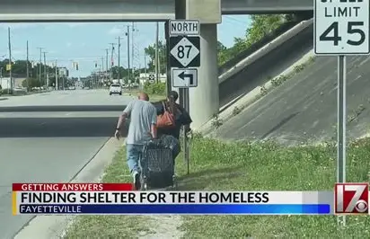

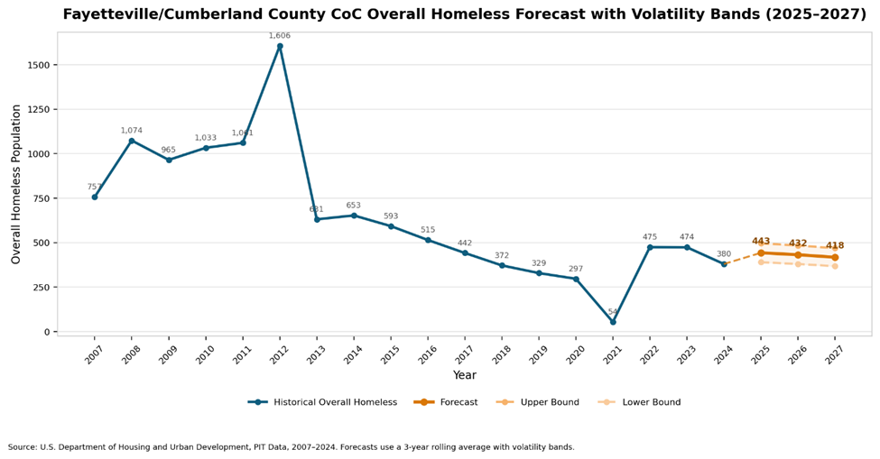
Key finding: Homelessness Trend
Cumberland County (2007–2024)
Peak around 2012, decline through 2021
Recent increase indicates renewed demand
System under continued pressure
Notes:
Our analysis of Cumberland County shows that homelessness peaked around 2012 and declined steadily through 2021.
However, recent data shows an increase, indicating renewed demand and pressure on the system.
We also found that a significant portion of individuals remain unsheltered.
This suggests that while some progress has been made, there are still gaps in outreach effectiveness and access to housing resources.
These findings highlight the need for more targeted interventions and improved strategies to connect individuals with housing.

Slide 14
Implementation
Need
Need for targeted interventions
Improve
Improve outreach to unsheltered individuals
Strengthen
Strengthen communication strategies
Enhance
Enhance resource navigation tools
Use
Use data to guide program improvements
Notes:
Based on our findings, several improvements are needed.
First, outreach efforts must be more targeted, especially toward unsheltered individuals.
Second, communication strategies should be strengthened to ensure information reaches the right people.
Third, resource navigation tools should be enhanced to help individuals move through the system more easily.
Finally, data should be continuously used to guide decisions and improve programs.
Implementation should focus on practical, data-driven changes that address the gaps we identified.

Slide 15
Recommendation
Implement segmentation‑based outreach
Expand digital + peer‑led communication channels
Develop personalized resource‑matching tools
Track KPIs consistently across programs
Integrate qualitative feedback into decision‑making
Notes:
We recommend implementing segmentation-based outreach strategies to better target different groups.
Organizations should expand digital and peer-led communication channels to increase engagement.
We also suggest developing personalized resource-matching tools to improve placement success.
Additionally, KPIs should be consistently tracked across programs to measure effectiveness.
Finally, qualitative feedback should be integrated into decision-making to ensure strategies reflect real-world experiences and needs.

Slide 16
Conclusion
Data‑driven outreach can significantly improve housing access
Combining analytics + marketing strategies strengthens engagement
Continuous evaluation ensures long‑term housing stability
This framework supports more effective, equitable homelessness response systems

Slide 17
Any Questions?
Notes:
Thank you for your time. We welcome any questions and are happy to provide further clarification on our methodology, findings, or recommendations.

Slide 18
References
Case Studies of Nonprofit Organizations Effectively Using ... (2025). https://socialtargeter.com/blogs/case-studies-of-nonprofit-organizations-effectively-using-data-analytics-to-drive-donations
Changing Perceptions on Homelessness Through ... (n.d.). Retrieved https://mediacause.com/our-work/case-study/changing-perceptions-mobilization-campaign/
Effective Messaging and the Solution to End Homelessness. (n.d.). Retrieved https://gomixte.com/blog/effective-messaging-solution-to-end-homelessness/
Evans, W., Phillips, D., & Ruffini, K. J. (2019). Reducing and Preventing Homelessness: A Review of the Evidence and Charting a Research Agenda. Randomized Social Experiments eJournal. https://www.nber.org/system/files/working_papers/w26232/w26232.pdf
Homelessness. (2025). https://isocialmarketing.org/homelessness/
Homelessness Toolkit to Support Local Businesses. (2025). https://fwhcc.org/homelessnesstoolkit/
Housing-Focused Street Outreach: Starting with Data to Inform Decision- ... (n.d.). Retrieved https://endhomelessness.org/webinars/housing-focused-street-outreach-starting-with-data-to-inform-decision-making/
How Can Social Marketing Help Reduce Homelessness in ... (2023). https://patimes.org/how-can-social-marketing-help-reduce-homelessness-in-the-united-states/
How to Leverage Data Analytics to Drive Non-Profit Growth. (2025). https://www.bradymartz.com/how-to-leverage-data-analytics-to-drive-non-profit-growth/
Innovative Marketing Strategies for Homeless Shelters. (2024). https://desygner.com/blog/industry/how-to-market-homeless-shelters-business
Kube, A., Das, S., & Fowler, P. J. (2019). Allocating Interventions Based on Predicted Outcomes: A Case Study on Homelessness Services. Proceedings of the AAAI Conference on Artificial Intelligence, 33(01), 622-629. https://doi.org/10.1609/aaai.v33i01.3301622
Marketing for Homeless Shelters and Housing Insecurity ... (n.d.). Retrieved https://nonprofit-nerd.com/marketing-homeless-shelters
Marshall CA, Boland L, Westover LA, Marcellus B, Weil S, Wickett S. Effectiveness of interventions targeting community integration among individuals with lived experiences of homelessness: A systematic review. Health Soc Care Community. 2020;28:1843–1862. https://doi.org/10.1111/hsc.13030
Navigating Homelessness and Housing Needs Data: Tailoring and ... (n.d.). Retrieved https://www.usich.gov/sites/default/files/document/Navigating-Homelessness-Housing-Needs-Data-2020-update.pdf
Nonprofit Analytics: Data Analysis Tools, Software & ... (2026). https://www.sopact.com/use-case/nonprofit-analytics
Social Media Marketing for Homeless Shelters - Waleed. (n.d.). Retrieved https://mwaleed.org/homeless-shelter-social-media-marketing/
Understanding the Role of Data Analytics in Homelessness Policy ... (2024). https://www.bitfocus.com/blog/role-of-data-in-homeless-policy-evaluation
Using OOH to Help the Homeless. (2019). https://oaaa.org/blog-posts/using-ooh-to-help-the-homeless/
White, H., Saran, A., Fowler, B., Portes, A., Fitzpatrick, S., & Teixeira, L. (2019). PROTOCOL: Studies of the effectiveness of interventions to improve the welfare of those affected by, and at risk of, homelessness in high‐income countries: An evidence and gap map. Campbell Systematic Reviews. https://journals.sagepub.com/doi/full/10.1002/cl2.1069
Why Data Analytics Is Within Reach for Nonprofits. (2026). https://www.mjcpa.com/why-data-analytics-is-wit
Notes:
These are the resourses that were used to support our research. Sources include academic studies, government data, and industry insights related to homelessness, marketing strategies, and data analytics as well as an organization that would like to remain anyomous.

